Slide 1
THE INTERACTION

Slide 2
THE INTERACTION
What is Interaction?
  Communication between the user and the system.
  Batch Input [Less Interactive]
  Direct Manipulation

Slide 3
THE INTERACTION
Models of Interaction
  Use of models can help us to understand
    Exactly what is going on in the interaction
    And identify the likely root of difficulties.

Slide 4
THE INTERACTION
  These models also provide us with a framework;
    To compare different interaction styles
    And to consider interaction problems.

Slide 5
THE INTERACTION
Terms of Interaction
  Domain – the area of work under study
    e.g. graphic design
  Goal – what you want to achieve / Desired output
    e.g. create a solid red triangle
  Task – how you go about doing it – ultimately in terms of operations or actions
    e.g. … select fill tool, click over triangle

Slide 6
THE INTERACTION
  Intention - is a specific action required to meet the goal.
  Task Analysis - the identification of the problem space for the User in terms of the Domain.
    The problem space is the initial state of the domain plus the goals the User wishes to achieve plus the set of operations allowable.

Slide 7
THE INTERACTION
Norman’s Execution-Evaluation Cycle
The user formulate a plan of action, which is then executed at the computer interface.
When the plan, or part of plan, has been executed,
  the user observes the computer interface to evaluate the result of the executed plan,
  and to determine further actions.

Slide 8
THE INTERACTION
The interaction cycle can be divided into two major phases;
  Execution
  Evaluation

Slide 9
THE INTERACTION
Execution
  Establishing the goal.
  Forming the intention.
  Specifying the action sequence.
  Executing the action.

Slide 10
THE INTERACTION
Evaluation
  Perceiving the system state.
  Interpreting the system state.
  Evaluating the system state with respect to the goals/intentions.

Slide 11
THE INTERACTION
Norman use this model of interaction to demonstrate why some interfaces cause problems to their users.
  Gulfs of Execution
  Gulfs of Evaluation

Slide 12
THE INTERACTION
Gulf of Execution
  Is the difference between the user’s formulation of the action to reach the goal and the action allowed by the system.

Slide 13
THE INTERACTION
Gulf of Evaluation
  Is the distance between the physical presentation of the system state and the expectation of the user.
Our Concern is to minimize both gulfs

Slide 14
THE INTERACTION
Human error - slips and mistakes
  slip
    understand system and goal
    correct formulation of action
    incorrect action
  mistake
    may not even have right goal!

Slide 15
THE INTERACTION
Fixing things?
  slip – better interface design
  mistake – better understanding of system

Slide 16
THE INTERACTION
Problem:
  execution-evaluation cycle only deals with the user’s view of interaction.
  Not deal with the system’s communication through the interface.

Slide 17
THE INTERACTION
Abowd & Beale’s model [Interaction Framework]
  Proposed a different framework with 4 components;
    System
    User
    Input
    Output

Slide 18
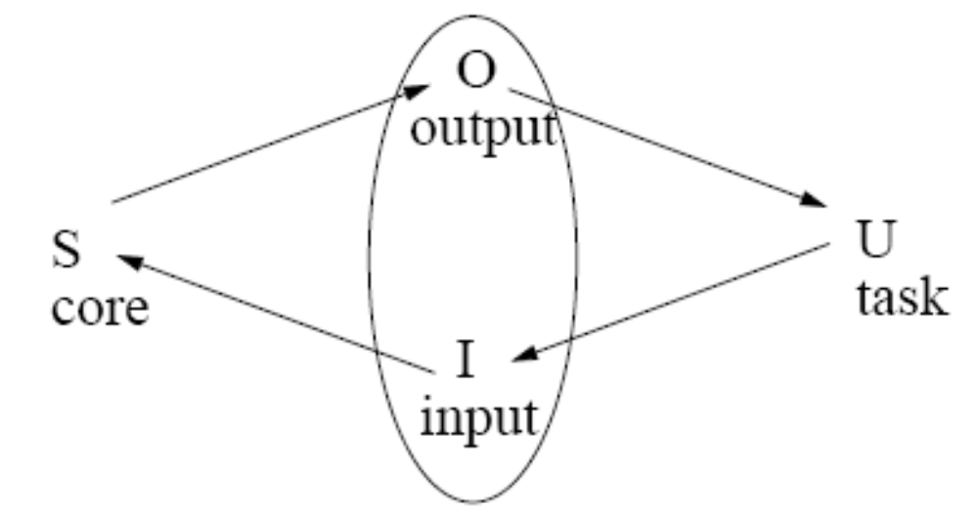
THE INTERACTION
Each Component has its own language.

Slide 19
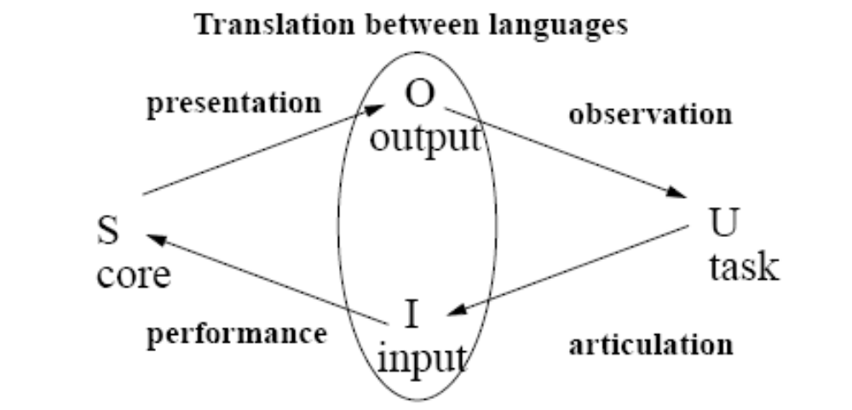
THE INTERACTION

Slide 20
THE INTERACTION
Articulation: from tasks to input and the relative ease of translation.
Performance: coverage of input language to full set of capabilities of system.
Presentation: coverage of relevant information to the output.
Observation: ease of evaluation by user of output information.

